Slide 1
CS2009-Design an analysis of Algorithm
Week 1
Dr. Muhammad Usman Ghous

Slide 2
Reference Books
T. Cormen, C. Leiserson, R. Rivest, and C. Stein. Introduction to Algorithms, 3rd Edition, MIT Press, 2011.
Introduction to the Design and Analysis of Algorithms by Anany Levitin
Other reference books are there in outline to be shared this week.
Class code: ctfqcyf
Contact: usman.ghous@nu.edu.pk

Slide 3
Project [Tentative]
Programming Project (Undergrad)
The UG students will be given to select a practical problem and they have to implement the optimal algorithm to solve the problem.
The problem as well as the algorithm will be chosen based upon the aptitude and inclination of the student, in consultation with the course instructor.

Slide 4
Course Objective
The course introduces students to advanced techniques in data structures as well as design and analysis of high-performance and scalable algorithms & their engineering applications.
What should you expect in this course?
Overview of some advanced data structures.
A number of algorithms and computational techniques to solve complex programming problems.
Programming
What should you learn by the end of this course
Ability to design and implement algorithms and techniques in the broad area of computational sciences

Slide 5
Important characteristics of a good software
A good design
Easy to implement
Easy to use
Easy to maintain
Reliable solution of the given problem

Slide 6
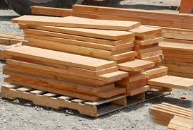
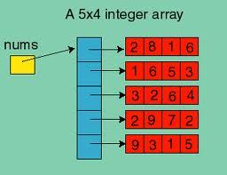
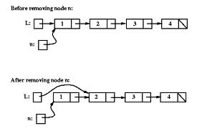
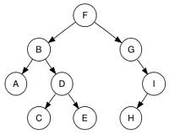
Some Example Data Structures
Arrays
Stack
Tree
Linked List
Data structure = representation and operations associated with a data type

Slide 7
Data Structure Applications
Arrays
lists (one dimensional arrays)
matrices (two dimensional arrays)
database applications
dynamic memory allocation
to implement other data structures, such as heaps, hash tables, queues, stacks, strings
Stacks
expression evaluation and syntax parsing
Queues
scheduling
transportation
operations management

Slide 8
Data Structure Applications
Trees
efficient searching of data (Binary search tree BST)
manipulate hierarchical data
manipulate sorted data
router algorithms
Linked lists
can be used to implement several other common abstract data structures, such as
stacks
queues
symbolic expressions, and etc

Slide 9
So, what exactly is an Algorithm
Algorithm:
A finite set of statements that guarantees an optimal solution in finite interval of time

Slide 10
What is an Algorithm?
In mathematics and computer science, an algorithm is a step-by-step procedure for solving a problem
expressed as a finite list of well-defined instructions
with a finite amount of data
in a finite amount of time
Algorithms are used for
calculation
data processing, and
automated reasoning
In simple words
an algorithm is a step-by-step procedure for calculations

Slide 11
The Algorithm to Start the Car
Insert the key
Make sure car is in neutral gear
Press the gas pedal/ (Accelerator)
Turn the key to the start position
If the engine starts in 6 seconds ➔
Release the key to the ignition position
Else if the engine does not start in 6 seconds ➔
Release the key and gas pedal
Wait for 10 seconds , and repeat the steps 3 – 6, but no more than 5 times
If the car does not start
Call the workshop

Slide 12
Good Algorithms?
Run in less time
Consume less memory
But computational resources (time complexity) is usually more important
Memory is not an issue now-a-days
Why time is important in algorithms?
Usability
Multiple users

Slide 13
Measuring Efficiency
The efficiency of an algorithm is a measure of the amount of resources consumed in solving a problem of size n.
The resource we are most interested in is time
We can use the same techniques to analyze the consumption of other resources, such as memory space.
It would seem that the most obvious way to measure the efficiency of an algorithm is to run it and measure how much processor time is needed
Is it correct
No, Computer has multiple processes to execute

Slide 14
Factors in solving the problem
Hardware
Operating System
Algorithm
Compiler
Size of input
Nature of Input
Which should be improved?

Slide 15
Running Time of an Algorithm
Depends upon:
Input Size
Nature of Input
Generally, time grows with size of input, so running time of an algorithm is usually measured as function of input size.
Running time is measured in terms of number of steps/primitive operations performed
Independent from machine, OS

Slide 16
Analysis of Algorithms
An algorithm is a finite set of precise instructions for performing a computation or for solving a problem.
What is the goal of analysis of algorithms?
To compare algorithms mainly in terms of running time but also in terms of other factors (e.g., memory requirements, programmer's effort etc.)
What do we mean by running time analysis?
Determine how running time increases as the size of the problem increases.

Slide 17
Asymptotic Notation, Review of Functions & Summations

Slide 18
Asymptotic Complexity
Running time of an algorithm as a function of input size n for large n.
Expressed using only the highest-order term in the expression for the exact running time.
Instead of exact running time, say Θ(n²).
Describes behavior of function in the limit.
Written using Asymptotic Notation.
Notes:
Τηεετα Θ(n²)- Exact time

Slide 19

Three types of notations are used to asymptotically bound an algorithm
Big-O, Omega($Ω$), and Theta are formal notational methods for stating the growth of resource needs (efficiency and storage) of an algorithm.
In simple words theoretically bound an algorithm with some function

Slide 20
Asymptotic Notation
Θ, O, Ω, o, ω
Defined for functions over the natural numbers.
Ex: f(n) = Θ(n²).
Describes how f(n) grows in comparison to n².
Define a set of functions; in practice used to compare two function sizes.
The notations describe different rate-of-growth relations between the defining function and the defined set of functions.

Slide 21
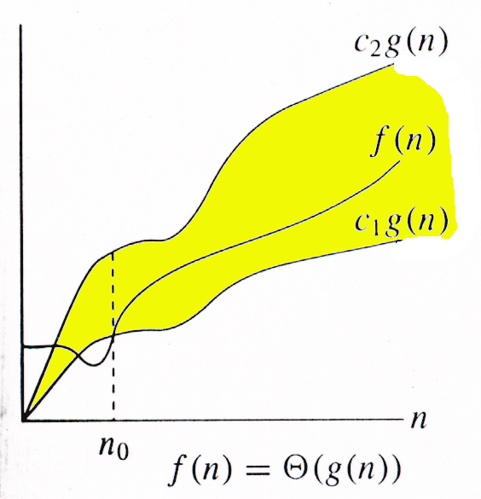
Θ-notation
For function g(n), we define Θ(g(n)), big-Theta of n, as the set:
Θ(g(n)) = {f(n) : ∃ positive constants c₁, c₂, and n_{0,} such that ∀n ≥ n₀,
we have 0 ≤ c₁g(n) ≤ f(n) ≤ c₂g(n)
}
Intuitively: Set of all functions that
have the same rate of growth as g(n).
g(n) is an asymptotically tight bound for f(n).

Slide 22
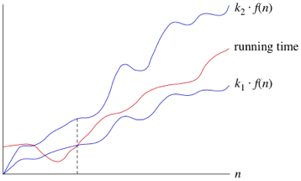
Theta
Theta notation describe the tighter bound of algorithm.
It basically combine the upper bound and also the lower bound of algorithm.
c2.g(n)
f(n)
c1.g(n)

Slide 23

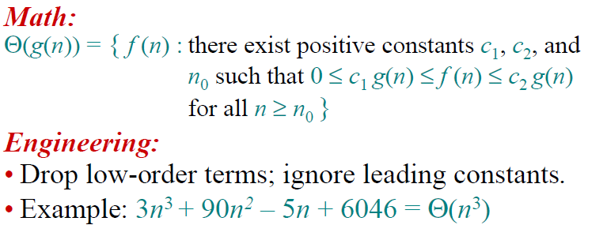

Slide 24
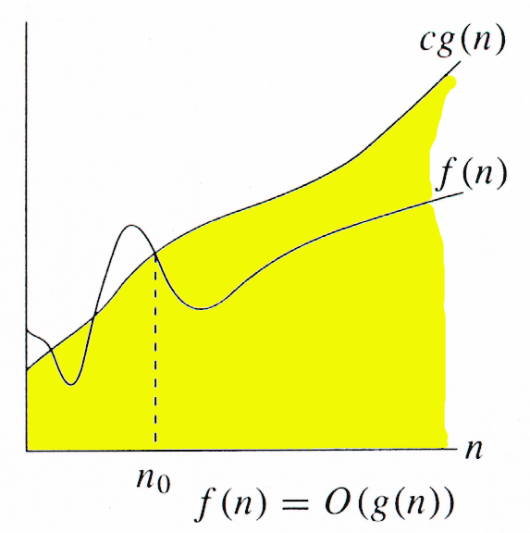
O-notation
For function g(n), we define O(g(n)), big-O of n, as the set:
O(g(n)) = {f(n) : ∃ positive constants c and n_{0,} such that ∀n ≥ n₀,
we have 0 ≤ f(n) ≤ cg(n) }
Intuitively: Set of all functions whose rate of growth is the same as or lower than that of g(n).
g(n) is an asymptotic upper bound for f(n).
f(n) = Θ(g(n)) ⇒ f(n) = O(g(n)).
Θ(g(n)) ⊂ O(g(n)).

Slide 25
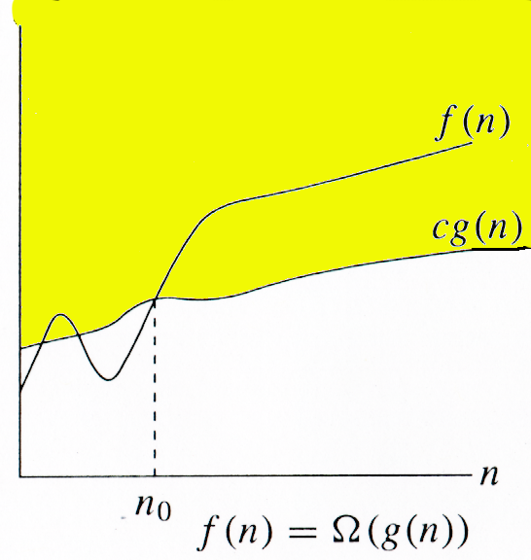
Ω -notation
For function g(n), we define Ω(g(n)), big-Omega of n, as the set:
Ω(g(n)) = {f(n) : ∃ positive constants c and n_{0,} such that ∀n ≥ n₀,
we have 0 ≤ cg(n) ≤ f(n)}
Intuitively: Set of all functions whose rate of growth is the same as or higher than that of g(n).
g(n) is an asymptotic lower bound for f(n).
f(n) = Θ(g(n)) ⇒ f(n) = Ω(g(n)).
Θ(g(n)) ⊂ Ω(g(n)).

